Slide 1
Generating Better Trade Show Leads
Presents:
Yes – You can “Guarantee” Your Trade Show Results

Slide 2
Your presenter
For 27 years, Hiett Ives has been a resource for companies searching for trade show success. Mr. Ives is a successful leadership and implementation authority in: • B2B corporate marketing and trade show management • “Time Sensitive”, quick turn around project management implementation • Writing and editing, from critical C level communications to basic manuals and brochures.
Show Dynamics clients are guaranteed qualified leads from their participation in B2B trade shows in any industry vertical, domestic and/or international.
Career successes include:
Organizing the first ever National Clear Air Conference
Managing participation in over 25 international oil industry shows in 12 countries on 5 continents

Slide 3
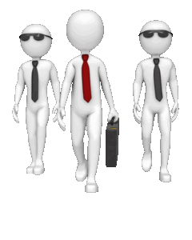
Today’s Agenda
Four Action Steps To Take BEFORE Exhibiting
A Few “Little Known Facts” About Exhibiting
What To Do As An Attendee (versus Exhibitor)
A Summary of Opportunities Available To You

Slide 4
Benefits You Receive
Tools to make your exhibit more inviting!

Slide 5
Let Us Begin
Notes:
Have you ever been an exhibitor at an attorney trade show?
Yes
No

Slide 6
Your Four Action Steps
Tell Them What You Do before you tell them Who You Are

Slide 7
Your Four Action Steps
Tell Them What You Do before you tell them Who You Are
Ask EVERYONE the SAME Open Ended Question

Slide 8
Your Four Action Steps
Tell Them What You Do before you tell them Who You Are
Ask EVERYONE the SAME Open Ended Question
Have a Leads Gathering/Leads Information System In Place

Slide 9
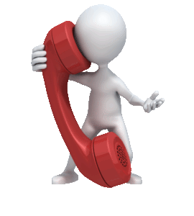
Your Four Action Steps
Tell Them What You Do before you tell them Who You Are
Ask EVERYONE the SAME Open Ended Question
Have a Leads Gathering/Leads Information System In Place
Have a Follow Up Program BEFORE You Go To The Show

Slide 10
OK - Let’s Delve Into This

Slide 11
Tell Them What You Do FIRST
Ani-Mate

Slide 12
Tell Them What You Do FIRST
Ani-Mate OR
Automatic Pet Feeders by Ani-Mate

Slide 13
Tell Them What You Do FIRST
Ani-Mate OR
Automatic Pet Feeders
Orange Research of Texas

Slide 14
Tell Them What You Do FIRST
Ani-Mate OR
Automatic Pet Feeders by Ani-Mate
Orange Research of Texas OR
Differential Pressure Control Equipment
by Orange Research of Texas

Slide 15
Point Two

Slide 16
Ask EVERYONE The Same Question
What’s an “Open Ended Question”?

Slide 17
Ask EVERYONE The Same Question
What’s an “Open Ended Question”?
“How do you…?”

Slide 18
Ask EVERYONE The Same Question
What’s an “Open Ended Question”?
“What’s your greatest (Product / Service) frustration?

Slide 19
Ask EVERYONE The Same Question
What’s an “Open Ended Question”?
“When was the last time you …?

Slide 20
Ask EVERYONE The Same Question
What’s an “Open Ended Question”?
“Who does your (SERVICE YOU OFFER)?”

Slide 21
Now – For # 3

Slide 22
Lead Gathering/Information System
When there’s a “Show Specific” system in place – USE IT
When there is no system present – create one yourself – For Instance, an app that reads barcodes.

Slide 23
Lead Gathering/Information System
Take notes about visitors IMMEDIATELY – you quickly forget unless you do – specifics about product/service or a personal note – invaluable for follow up!
Example: Joe Nice –
Needs specs on XYZ
Son just started college

Slide 24
And Last – So VERY Important

Slide 25
Establish Your Follow Up Program BEFORE The Show Begins
Compose follow up message BEFORE you go to the show.
Send initial follow up from show floor at end of day or immediately following show
Incorporate a tracking/accountability/deadline program with all leads
Begin Follow Up within 24 to 72 hours – sooner if possible

Slide 26
Let’s Take A Breather
Notes:
What does “ANI-MATE” do?
a. Creates Computer Animation
b. Makes Pet Feeders
c. Organizes On Line Dating

Slide 27
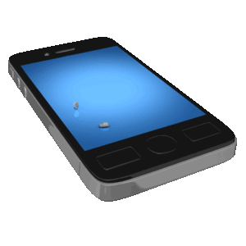
Little Known (And True) Trade Show FACTS
ALL tradeshows are LOCAL

Slide 28
Little Known (And True) Secrets
ALL tradeshows are LOCAL
70% of all attendees at ANY show come from a 300 mile radius

Slide 29
Little Known (And True) Trade Show FACTS
ALL tradeshows are LOCAL
70% of all attendees come from a 300 mile radius
An “End Cap” 10x10 booth appears to be 40% larger than its “In Line” counterpart

Slide 30
Little Known (And True) Trade Show FACTS
ALL tradeshows are LOCAL
70% of all attendees come from a 300 mile radius
An “End Cap” 10x10 booth appears to be 40% larger than its “In Line” counterpart
A 10x20 booth is 4 times more likely to be remembered than a 10x10 booth

Slide 31
More Little Known Trade Show Facts
5. Trade Show leads are LESS EXPENSIVE to close than “Traditional” Leads

Slide 32
More Little Known Trade Show Facts
5. Trade Show leads are LESS EXPENSIVE to close than “Traditional” Leads
6. Upwards to 80% of all Trade Show leads are left UNWORKED

Slide 33
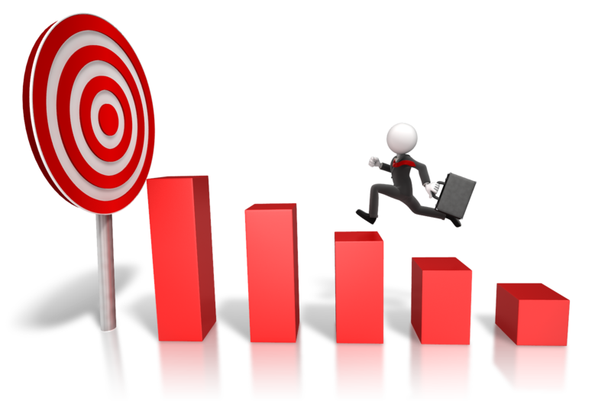
More Little Known Trade Show Facts
5. Trade Show leads are LESS EXPENSIVE than “Traditional” Leads
6. Upwards to 80% of all Trade Show leads are left UNWORKED
7. Those who work the full 100% of their leads are the WINNERS in the 80/20 reality

Slide 34
Let’s Talk “In Booth” Protocol

Slide 35
While In Your Booth
You MUST Refrain From:
Working on/talking on your computer, I Pad, Phone
Eating in your booth
Sitting in a chair

Slide 36
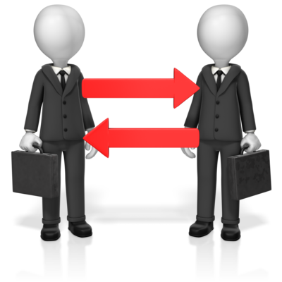
When You’re Away From Your Booth
Visit exhibitors who have visited YOUR booth – learn more about THEM and THEIR operation, needs, requirements
Prospect other exhibitors to come visit YOUR booth – especially during daily “exhibitor only” pre-show opening hour

Slide 37
When Away From Your Booth
Meet casually or in a business meeting with attendees/other exhibitors
Attend appropriate educational sessions

Slide 38
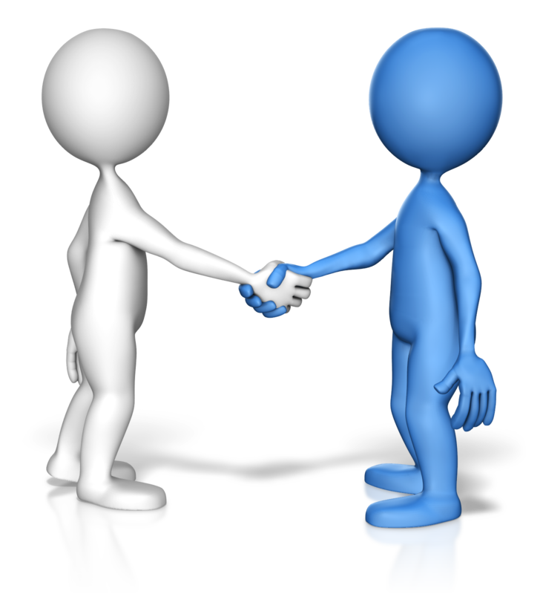
Here’s Another Twist
Notes:
Have you ever attended an attorney trade show as an attendee only?
Yes
No

Slide 39
When You Just ATTEND -v- Exhibit
REMEMBER –
Exhibitors are looking for BUYERS rather than SELLERS
Avoid coming off as the LATTER -
Even when you ARE!!

Slide 40
When You Just ATTEND -v- Exhibit
Use the same “Open Ended Question” approach to identify the person(s) with whom you want to/need to visit.

Slide 41
When You Just ATTEND -v- Exhibit
“Who’s responsible for/Who handles your….?”
“Are they attending the show…?”
“What’s the best way to get in touch with them…?”
“Thank You – Goodbye”

Slide 42
When You Just ATTEND -v- Exhibit
If They’re Attending and You Meet Them
I realize this is an inappropriate time to talk about…
When is a good time to call you, or can we set an appointment to get together…?
Have a great show, Thank You, Goodbye
Then LEAVE

Slide 43
When You Just ATTEND -v- Exhibit
All the above is equally applicable to:
a. Visiting with a fellow attendee at a technical session
b. Sharing a meal/snack with fellow attendee
c. Striking up conversation at networking reception or other general gathering with a fellow attendee

Slide 44
In Summary
Your Four Action Steps Are:
Notes:
Which of these are going to make your trade show participation more meaningful? Slide 47
a. Telling attendees What You Do before you tell them Who You Are
b. Asking all attendees the same qualifying/disqualifying ‘Open Ended Question’
c. Have your post-event follow up program in place BEFORE the show
d. All the above
Answer – d

Slide 45
In Summary
Your Four Action Steps Are:
Tell them ‘What You Do’ before you tell them ‘Who You Are’

Slide 46
In Summary
Your Four Action Steps Are:
2. Ask All Attendees The Same “Open Ended Question”

Slide 47
In Summary
Your Four Action Steps Are:
3. Have Your Leads Gathering/Qualifying System In Place In Advance

Slide 48
In Summary
Your Four Action Steps Are:
4. Begin Follow Up IMMEDIATELY following the encounter!

Slide 49
In Summary
Over the last 50 minutes or so, you’ve received information on:
Four Steps you can take to enhance you trade show participation
Inside ‘facts’ that give you an edge over other exhibitors

Slide 50
Your ACTION STEPS
YOUR Bonus for joining us LIVE today:
A copy of this presentation.
A custom Show Planning Guide.
The first THREE respondents to this offer will receive a half hour trade show consult with Show Dynamics – a $150 value
Anyone past the first three who respond before close of business this Friday, Sept. 16, can have the same half hour consult for just $47.

Slide 51
2129 Clinton Dr
Galena Park, TX 77547
Tel: (832) 358-2002
sales@tradesho.com
http://www.exhibitorsservicenetwork.com

